Slide 1
Objectives
Learn about sound file formats and properties
Embed a sound clip using the audio element
Embed a sound clip using the embed element
Learn about video file formats and properties
Embed a video clip using the video element

Slide 2
Objectives
Embed a video clip using the object element
Explore how to use Shockwave Flash players
Explore how to embed YouTube videos
Explore the history of Java
Embed a Java applet and other Objects

Slide 3
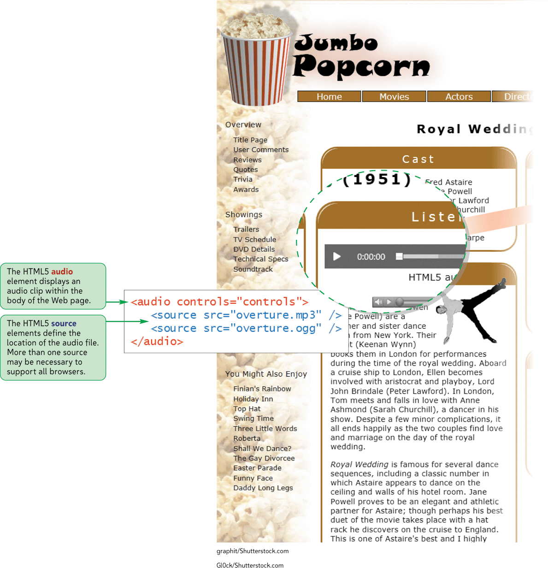
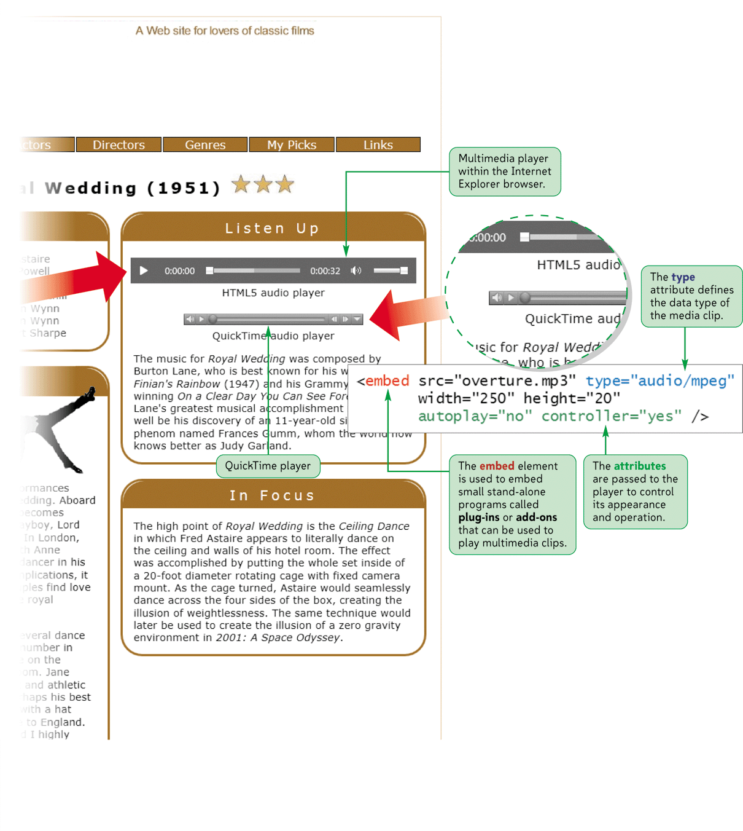
Playing Web Audio

Slide 4
Introducing Multimedia
Bandwidth is a measure of the amount of data that can be sent through a communication pipeline each second.
Consider bandwidth when working with multimedia on a Web site
Multimedia is much more accessible to Internet users because of high-speed internet connections and the reduction of the file size of multimedia clips

Slide 5
Introducing Multimedia
Multimedia is displayed within a Web page in a fashion similar to an inline images
Controls are displayed as part of the Web page
To play a multimedia file, a browser often will have access to a plug-in or add on
Starting with the widespread adoption of HTML5, many browsers now include built-in support for audio and video files, removing the need for plug-ins

Slide 6
Exploring Digital Audio
Every sound wave is composed of two components:
Amplitude- the height of the sound wave
Relates to sound’s volume
Frequency- the speed at which the sound wave moves
Relates to sound’s pitch

Slide 7
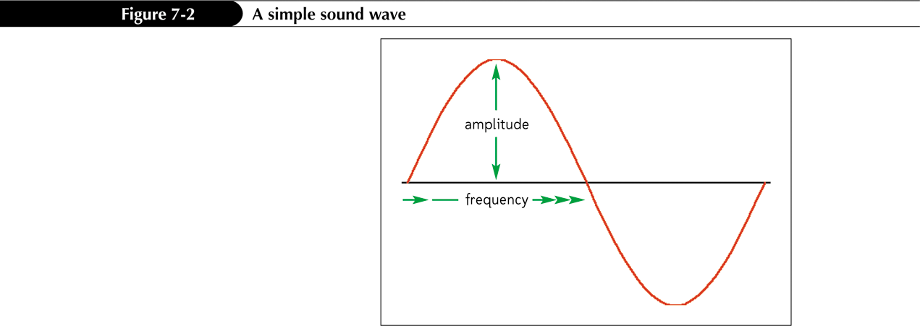
Exploring Digital Audio

Slide 8
Exploring Digital Audio
You hear sounds as a continuously varying signal
Must be converted to digital format to store as a computer file
Digital recording measures the sound’s amplitude at discrete moments in time
Each measurement is called a sample
Samples per second taken is called the sampling rate

Slide 9
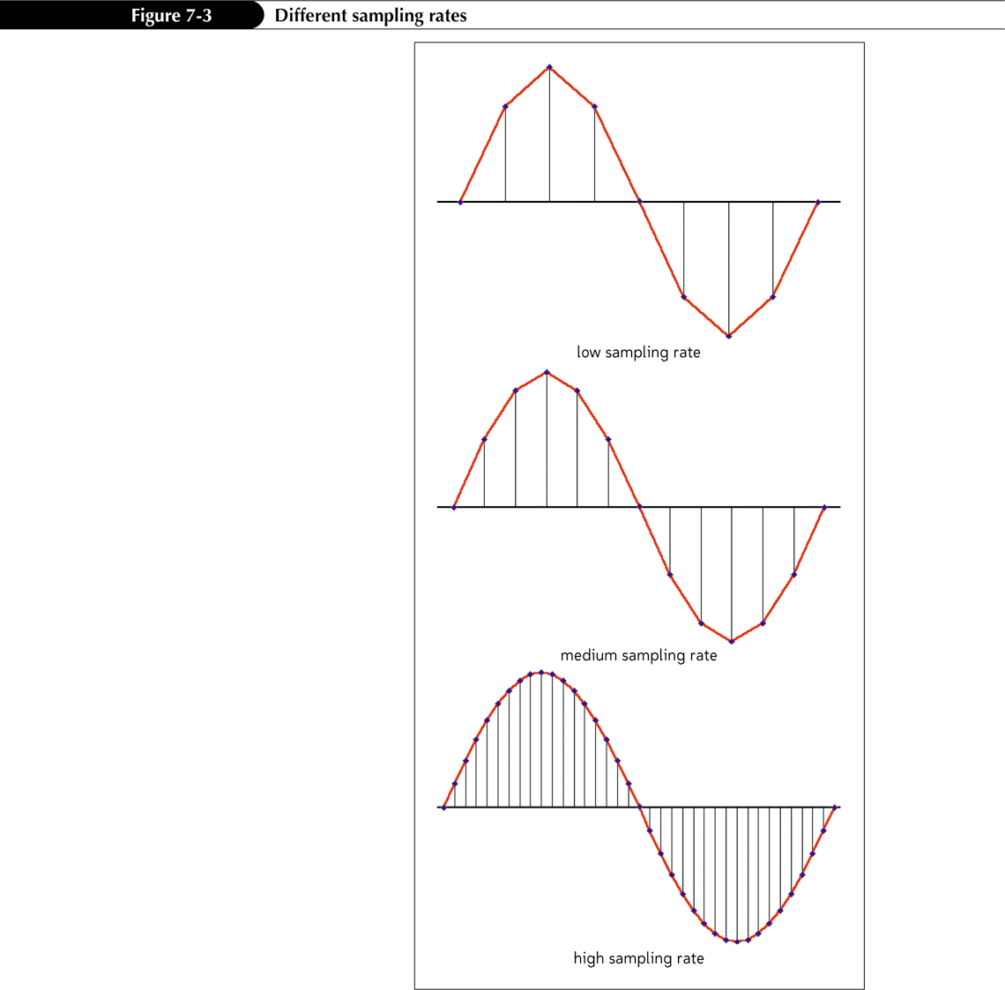
Exploring Digital Audio

Slide 10
Exploring Digital Audio
Sampling resolution (also called bit depth) indicates the precision in measuring the sound within each sample.
8-bit
16-bit
32-bit

Slide 11
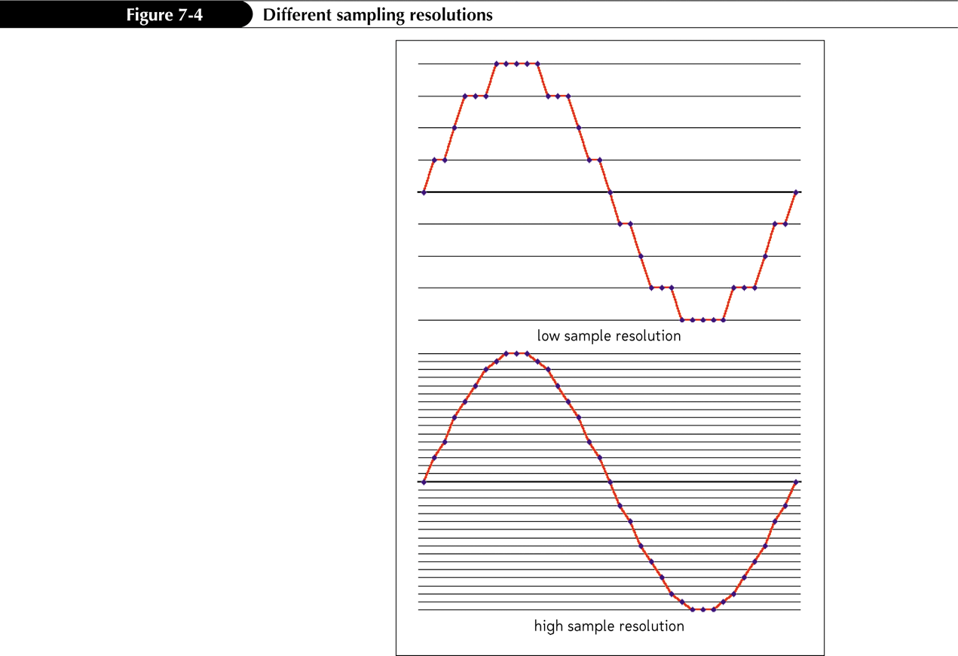
Exploring Digital Audio

Slide 12
Exploring Digital Audio
There are different sound file formats used for different operating systems.
Different file formats provide varying levels of sound quality and file compression.

Slide 13
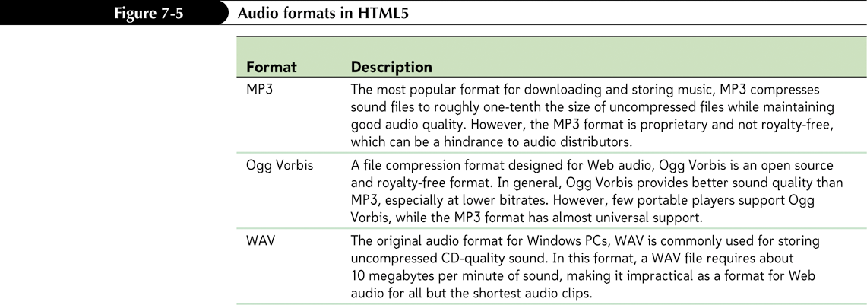
Exploring Digital Audio

Slide 14
Adding HTML5 Audio
To add an audio clip under HTML5, use the audio element
<audio>
<source src=”url1” />
<source src=”url2” />
…
</audio>
where url1, url2, etc. are the possible sources of the audio clip.

Slide 15
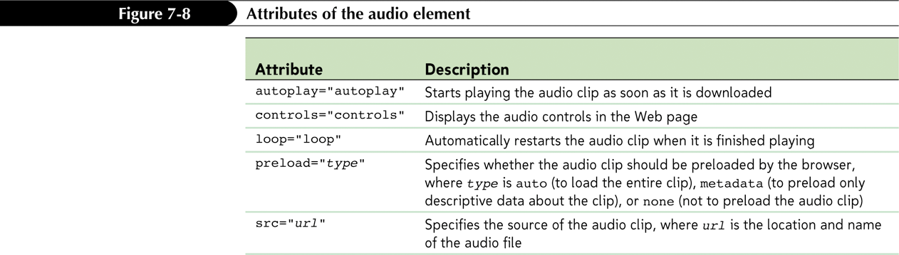
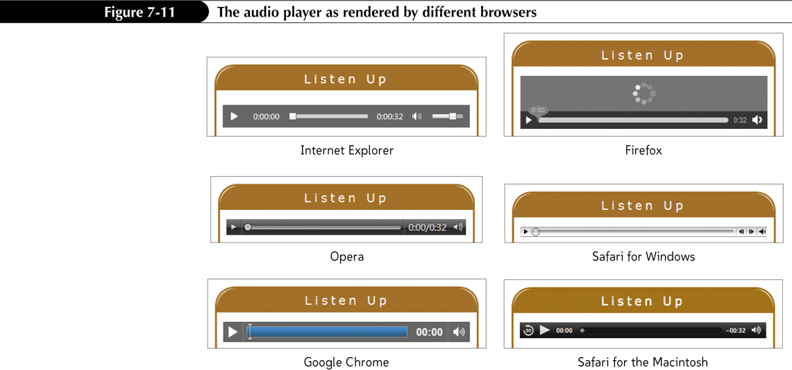
Adding HTML5 Audio

Slide 16
Working with Embedded Objects
Older browsers that don’t support the HTML5 audio element instead rely on plug-ins to play embedded media clips
To insert an embedded object such as a media player, you can nest the embed element within the audio element
Browsers recognizing the audio element will attempt to load the audio clip that way

Slide 17
Working with Embedded Objects
<audio src=”overture.mp3”>
<embed src=”overture.mp3” type=”audio/mpeg” width=”250” height=”10” />
</audio>

Slide 18
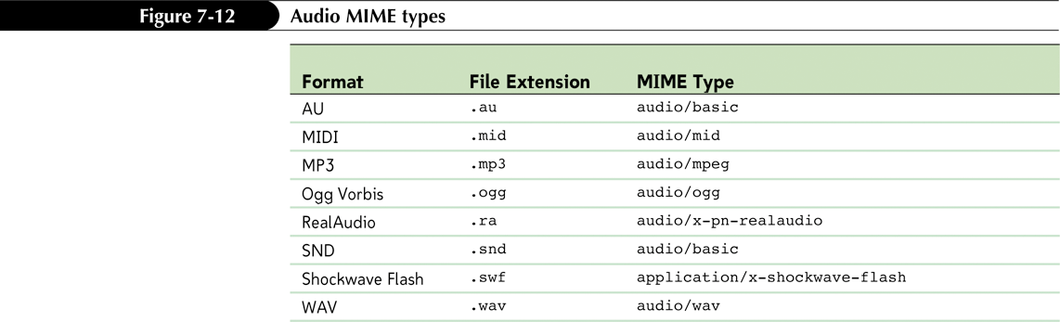
Working with Embedded Objects
The MIME types identify the type of data contained in the file

Slide 19
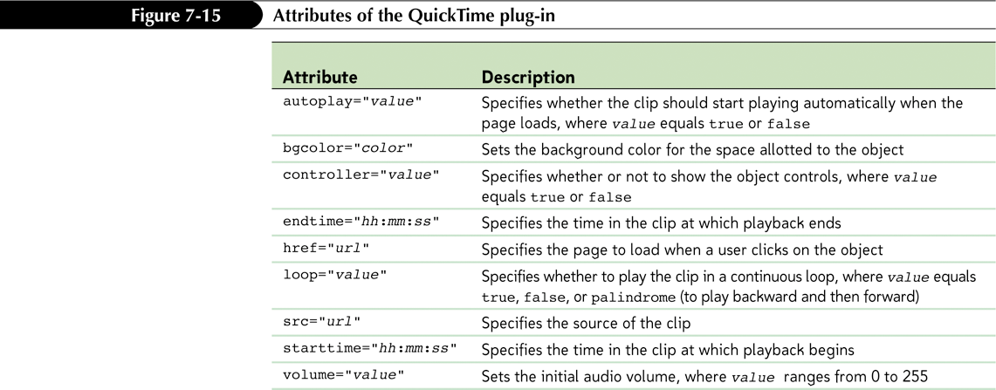
Working with Embedded Objects
The src, type, height, and width attributes constitute the basic HTML attributes for the embed element, but they do not specify how users interact with the embedded object

Slide 20
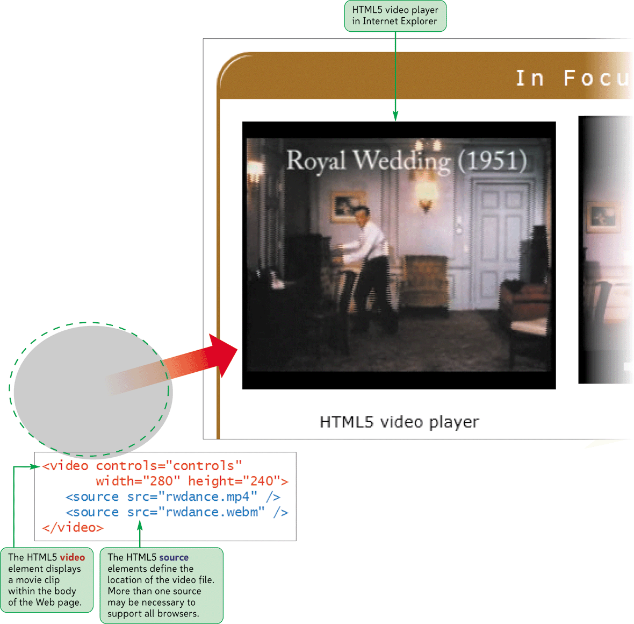
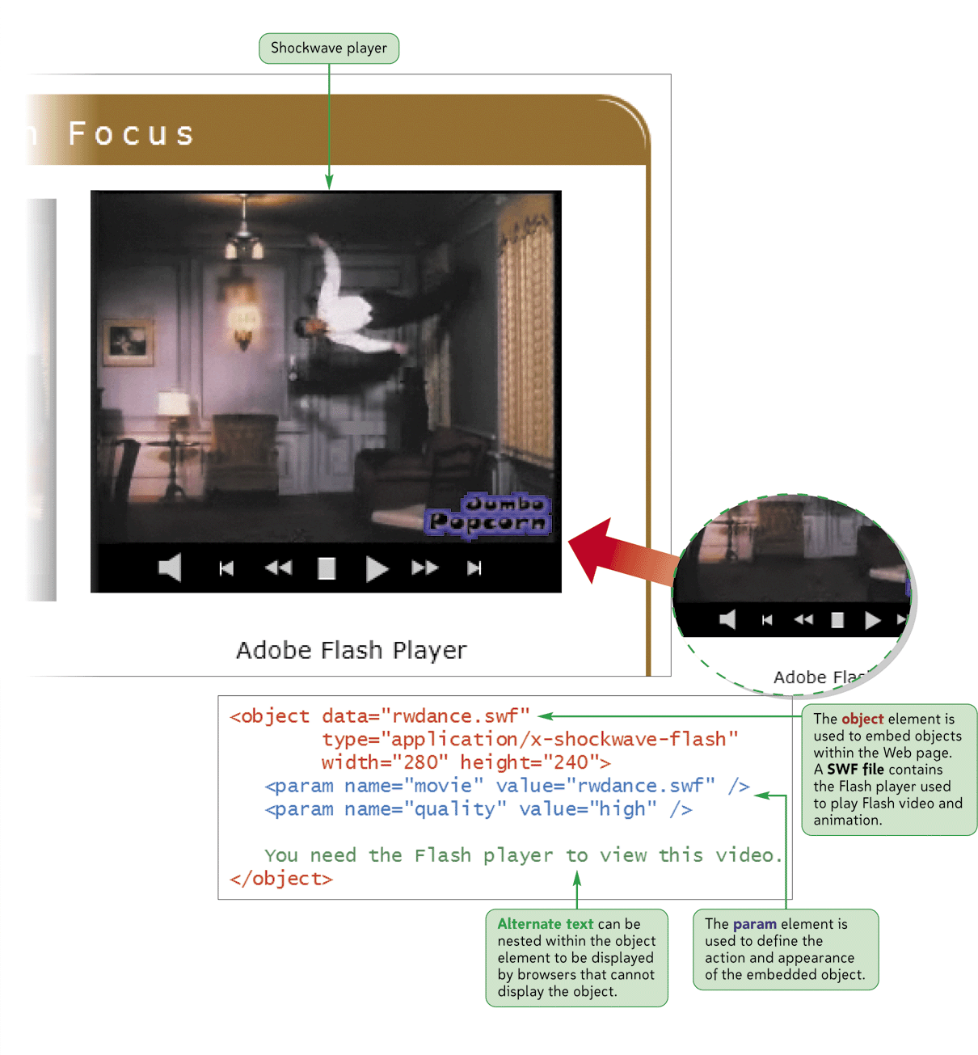
Playing Web Video

Slide 21
Exploring Digital Video
Digital video adds a visual element to a Web page as well as provides information
Video files are composed of a series of single images called frames
Many frames are sized to have width-to-height ratios or aspect ratios of 4:3, though theatrical releases typically have aspect ratios of 1.85:1 or 2.39:1
The video bit rate, which is the amount of data that has to be processed by the video player each second
The number of frames shown in a period of time is the frame rate

Slide 22
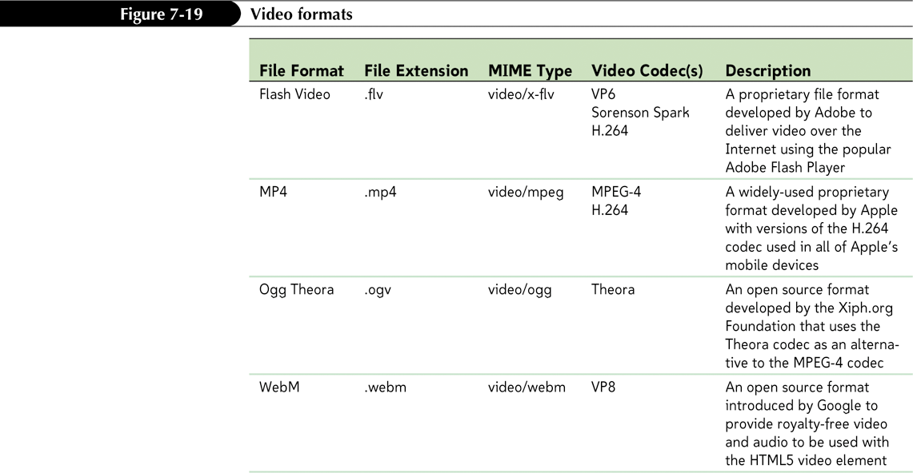
Exploring Digital Video

Slide 23
Adding Video in HTML5
To add a video clip with HTML5 use
<video>
<source src=”url1” />
<source src=”url2” />
…
</video>
where url1, url2, etc. are the possible sources of the video clip.

Slide 24
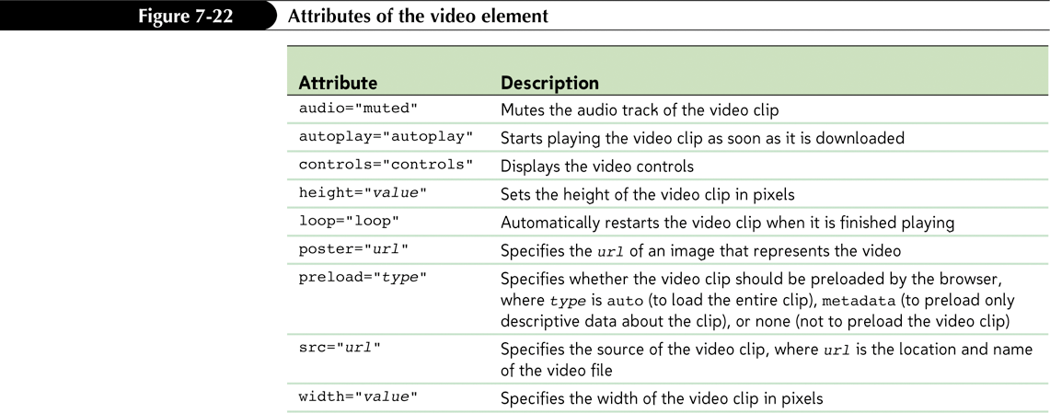
Adding Video in HTML5

Slide 25
Introducing the object Element
The object element was introduced in the specifications for HTML 4 for the purpose of marking any kind of nontextual content
The object element replaced the embed element, which was widely supported though never part of the previous HTML specifications released by the W3C
<object attributes>
parameters
</object>

Slide 26
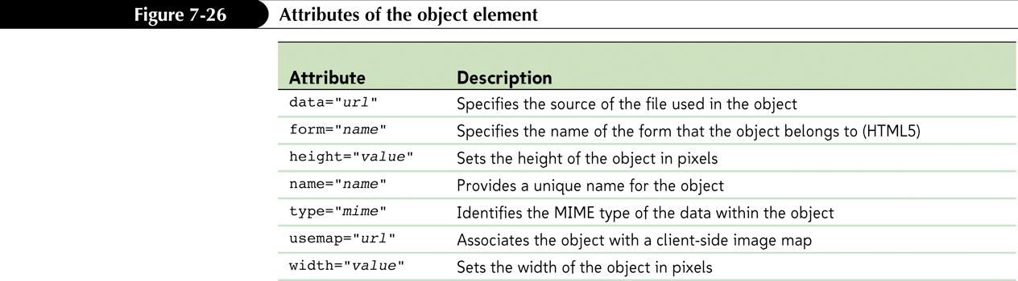
Introducing the object Element

Slide 27
Adding a Flash Player File
To add a Flash player (.swf) file, use the object element
<object data=”url”
type=”application/x-shockwave- flash” width=”value” height=”value”>
<param name=”movie” value=”url” />
parameters
</object>
where url is the location and filename of the SWF file, and parameters is other parameter elements that manage the appearance and actions of the player

Slide 28
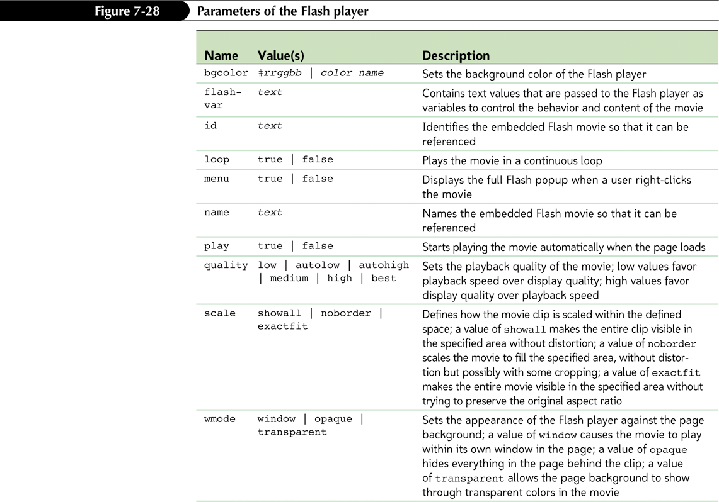
Adding a Flash Player File

Slide 29
Embedding Videos from YouTube
YouTube videos are embedded using either the YouTube Shockwave Flash player file (.swf) or, depending on each user’s device and playing preferences, an HTML5 video player. <object width=”value” height=”value”>
<param name=”movie” value=”url” />
parameters
<embed src=”url”
type=”application/x-shockwave- flash” width=”value” height=”value” parameters />
</object>

Slide 30
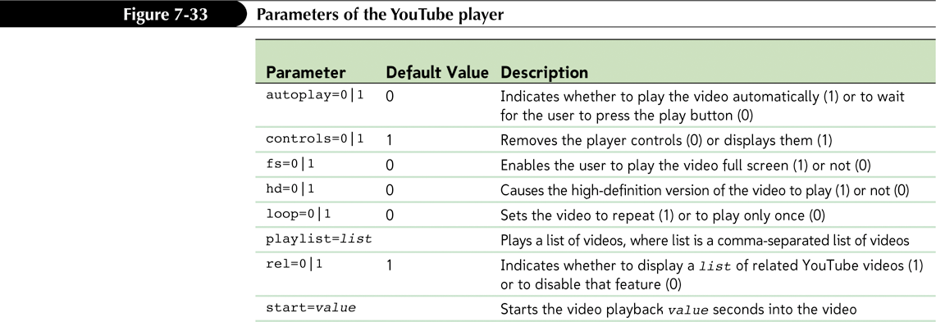
Embedding Videos from YouTube

Slide 31
The object Element and ActiveX
Internet Explorer supports a technology called ActiveX to play embedded media
ActiveX employs reusable software components that can be run from within a variety of Windows programs
Each ActiveX component is identified by a unique string of characters called the class id.

Slide 32
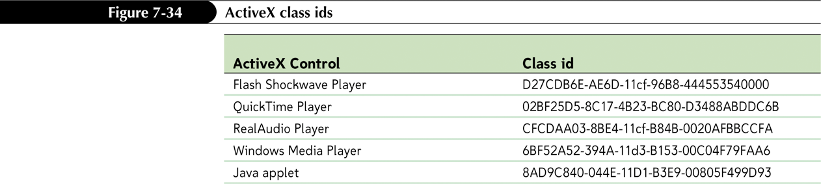
The object Element and ActiveX

Slide 33
The codebase Attribute
When a browser encounters a plug-in or an ActiveX control that it doesn’t recognize, it usually leaves a blank space where the embedded object normally would appear
One way of dealing with this problem is to provide browsers with information about where a working version of the plug-in or control can be downloaded

Slide 34
The codebase Attribute
<object classid=”clsid:02BF25D5- 8C17-4B23-BC80-D3488ABDDC6B” codebase=”http://www.apple.co m/qtactivex/qtplugin.cab”>
parameters
</object>

